Slide 1

MICRON – HF WASTEWATER TREAMENT
SIMULATION & BENCH TESTING – Dec 2021
Siva Kumar Kota/Chun Yew
Hiep Le/Sankar
Part 6

Slide 2
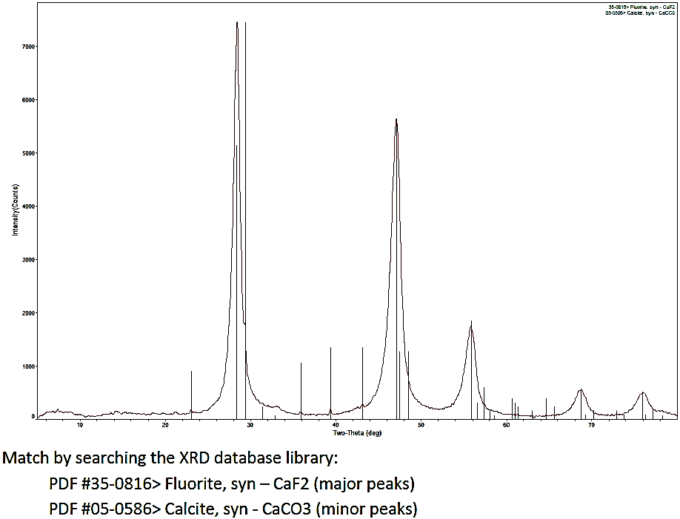
^{Combined Sludge XRD analysis}
Dosage: 6000 mg/l of lime and 4000 mg/l of CaCl2
2

Slide 3
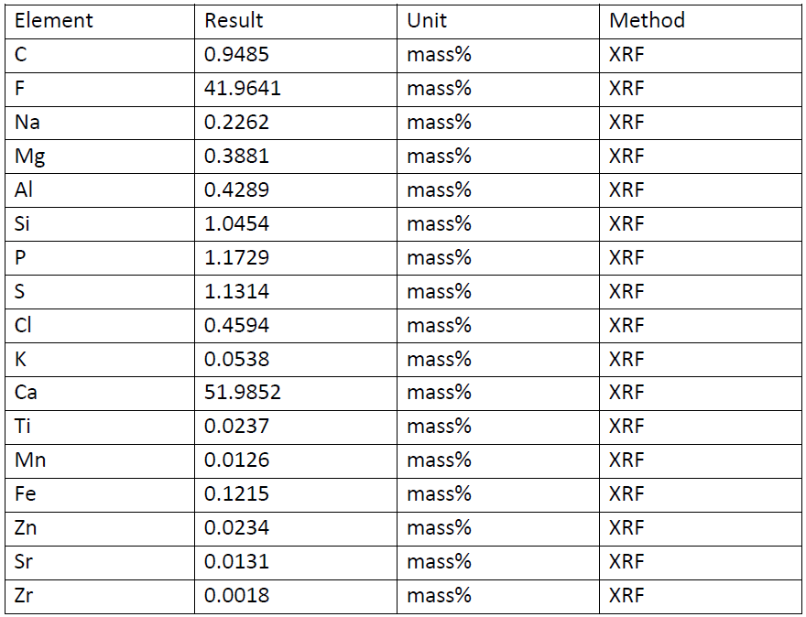
^{Combined Sludge XRD analysis}
XRF Results shows that Calcium fluoride sludge as a major part (>80%)
Dosage: 6000 mg/l of lime and 4000 mg/l of CaCl2
3

